Slide 1
Concurrency in Java
Vivek Gohil

Slide 2
Agenda
Threads In Java
Synchronization Mechanism
Java Memory Model
Introduction to Concurrency
Executors and Thread Pools
Concurrent Collections
Java’s High-Level Concurrency Utility
Best practices for Concurrent Programming

Slide 3
Threads in Java
What is Thread and Why we use Threads?
Creating Threads
Extending Thread vs Implementing Runnable
Using Callable and Future
Thread Management
Naming Thread
Thread Priorities
sleep(), yield(), join(), interrupt()
Demon vs User Thread

Slide 4
What is a Thread in Java?
A Thread is the smallest unit of execution within a program.
In Java, a Thread is a lightweight process that runs inside the JVM.
A single Java program (process) can have one thread(main Thread) or multiple Threads running concurrently.
Think of a Thread as a separate path of execution for your code.
The main() method runs on the main Thread by default.
You can create extra Thread to do work parallel or concurrently.

Slide 5
Why We Use Threads?
Threads are used when you don’t want one task block others.
Key Reasons:
Better Performance
Multiple tasks can run simultaneously(especially on multi-core CPU).
Example: Processing large files while handling user requests.
Responsiveness
Keep the application responsive to user input while doing background work.
Example: UI stays responsive while downloading a file.
Better Resource Utilization
CPU and I/O can be used together – while one Thread waits for I/O, another uses CPU.
Parallelism for Heavy Tasks
Dividing big tasks into smaller chunks and run them in parallel(e.g. Image processing, Sorting)

Slide 6
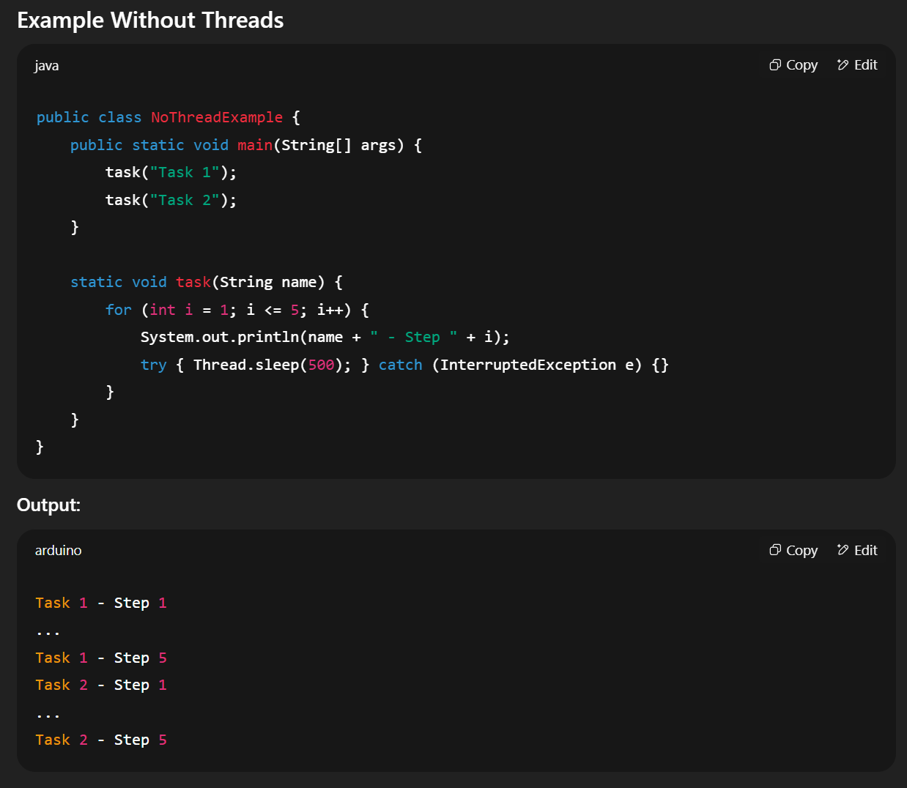
Example

Slide 7
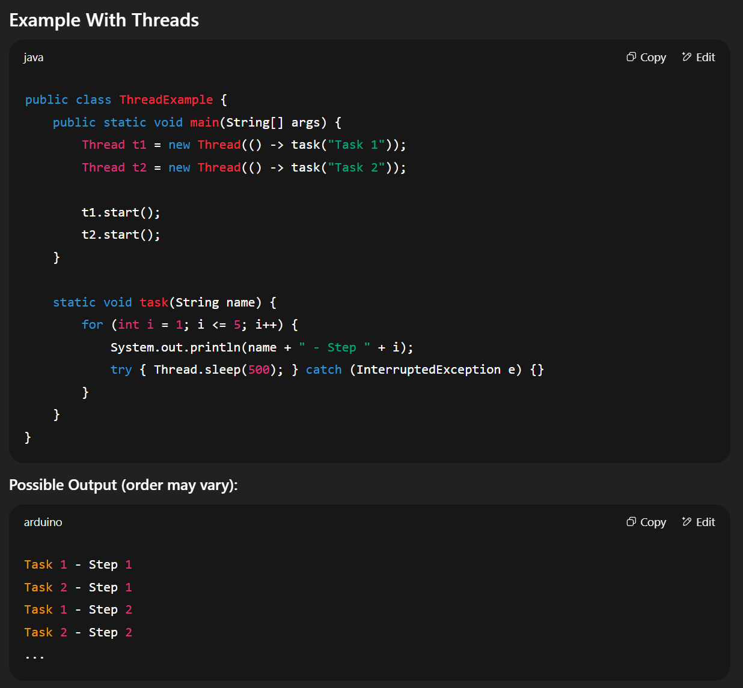
Example

Slide 8
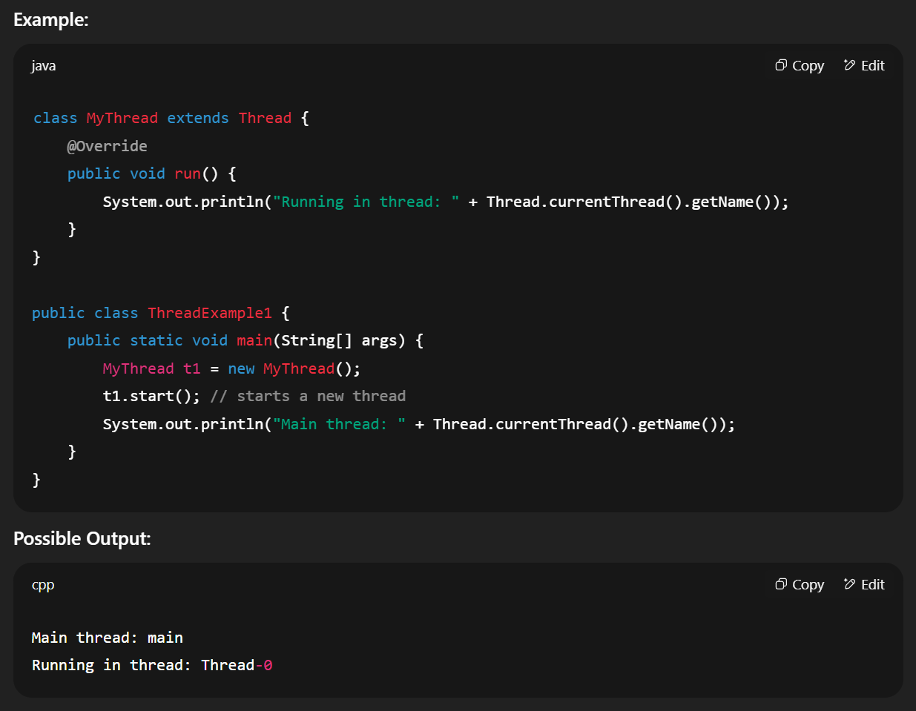
Ways to Create Threads in Java
Extending the Thread Class

Slide 9
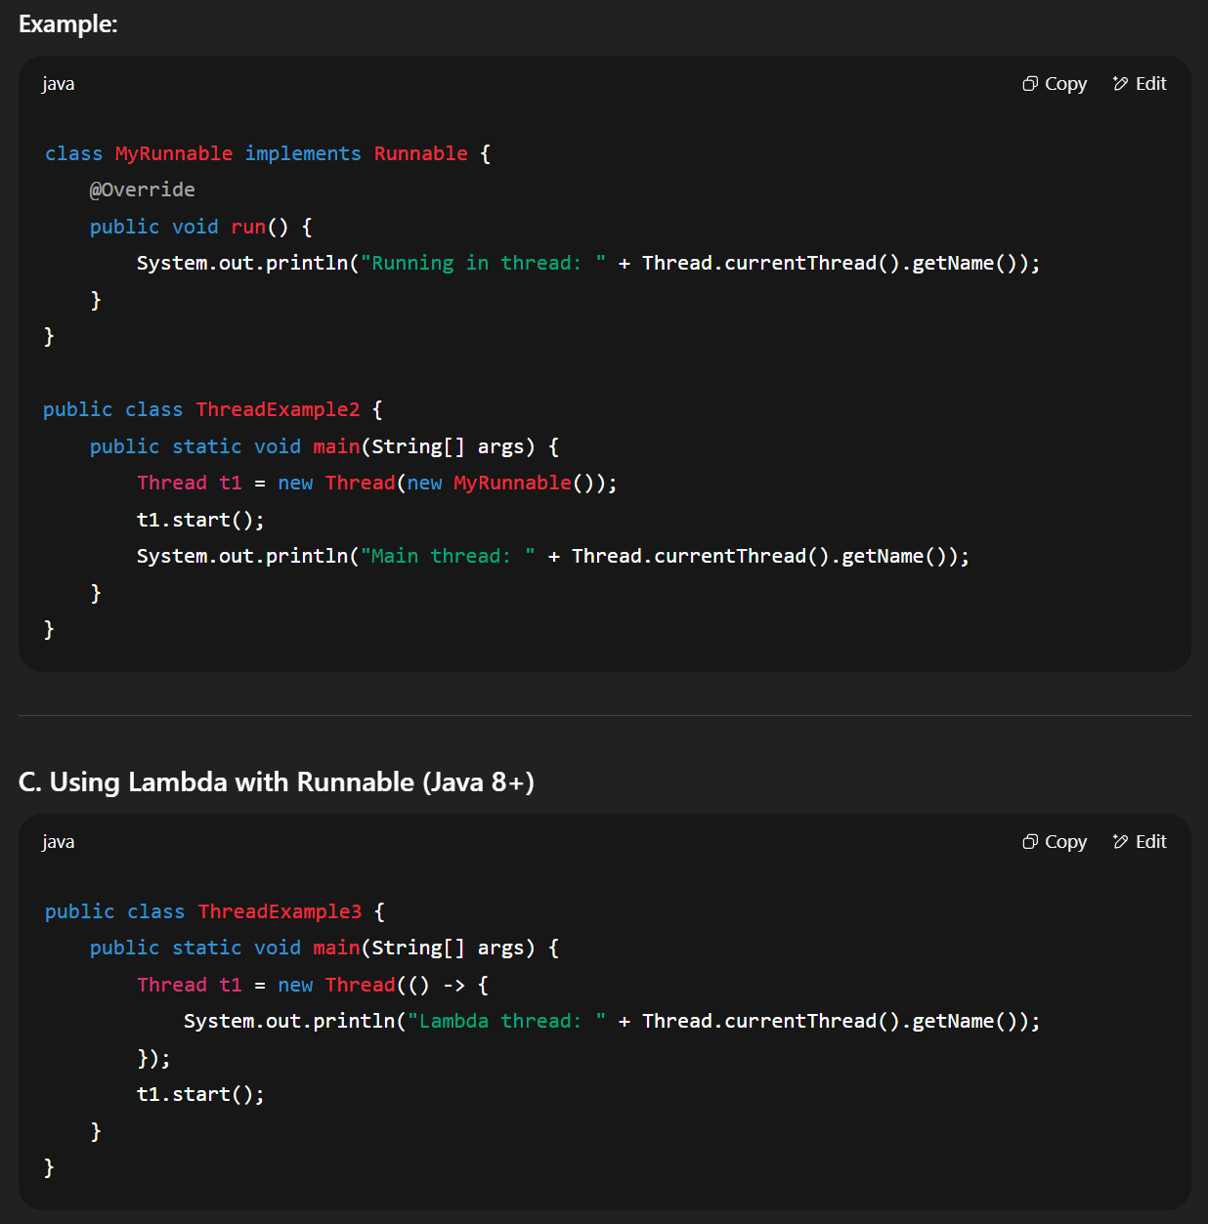
Ways to Create Threads in Java
Implementing Runnable Interface

Slide 10
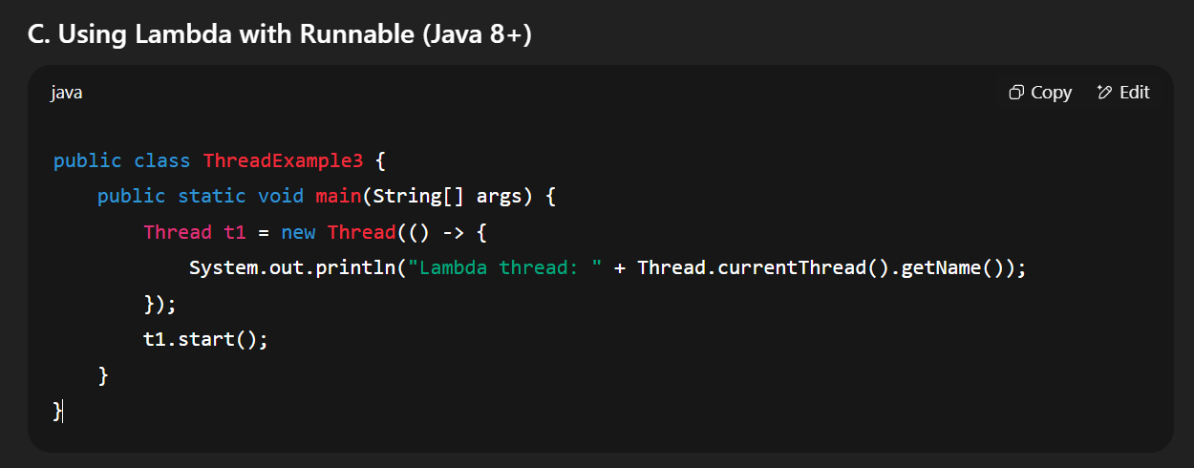
Ways to Create Threads in Java
Using Lambda Expressions

Slide 11
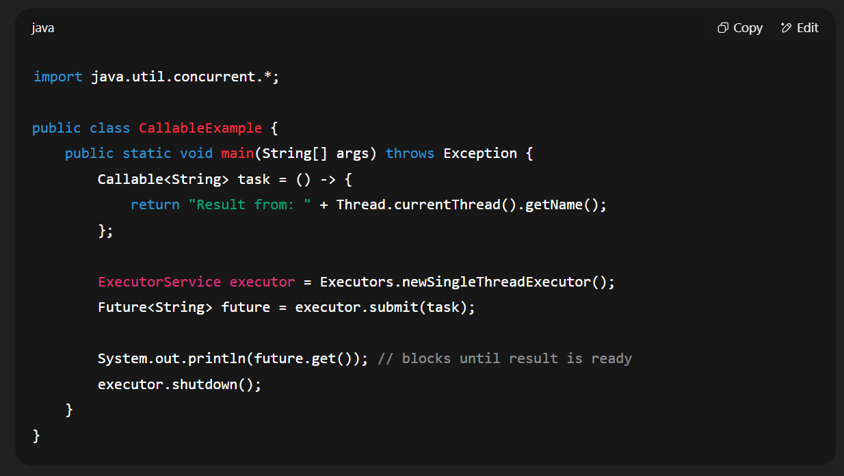
Callable & Future
Callable can return value and throw exceptions.
You need ExecutorService to run it.

Slide 12
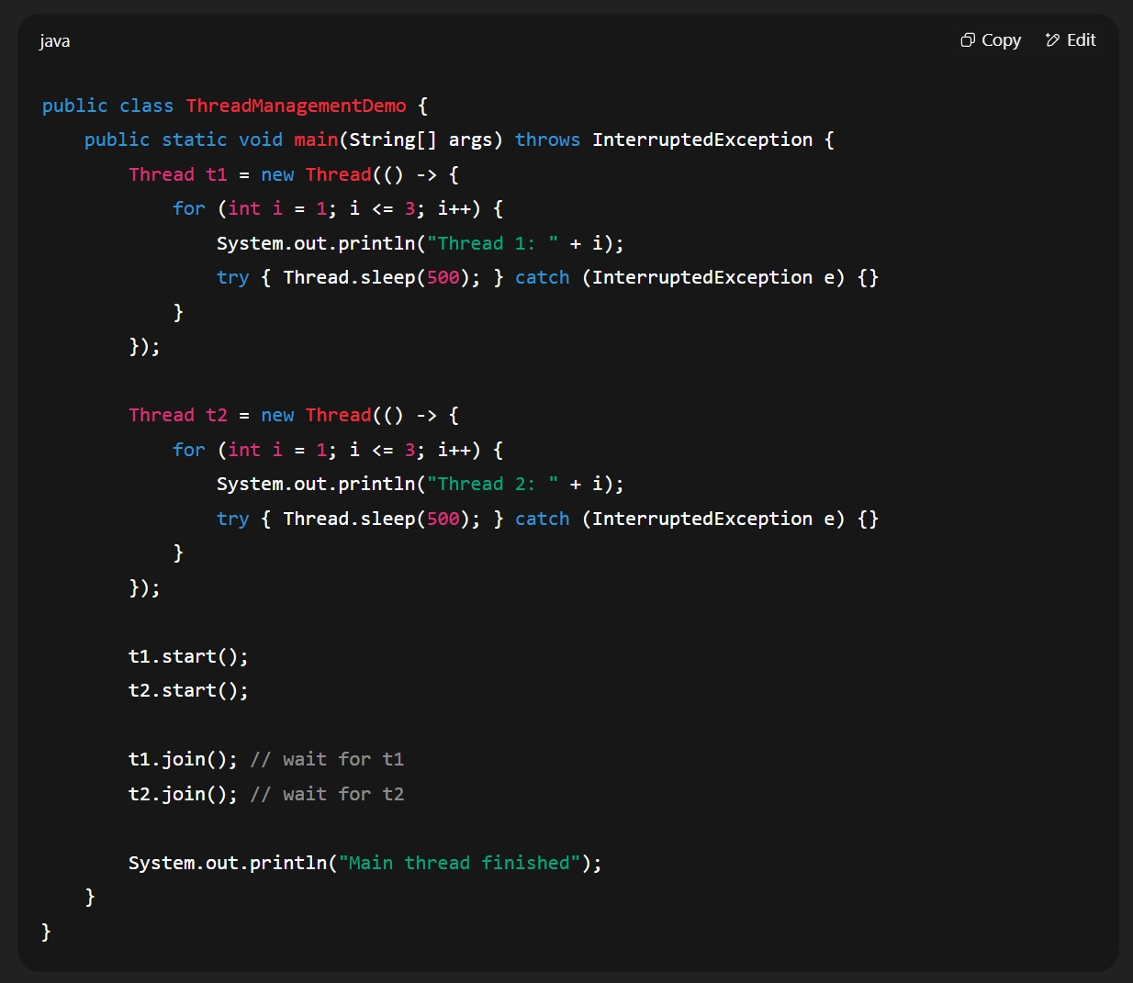
Example Demonstrating sleep() and join()

Slide 13
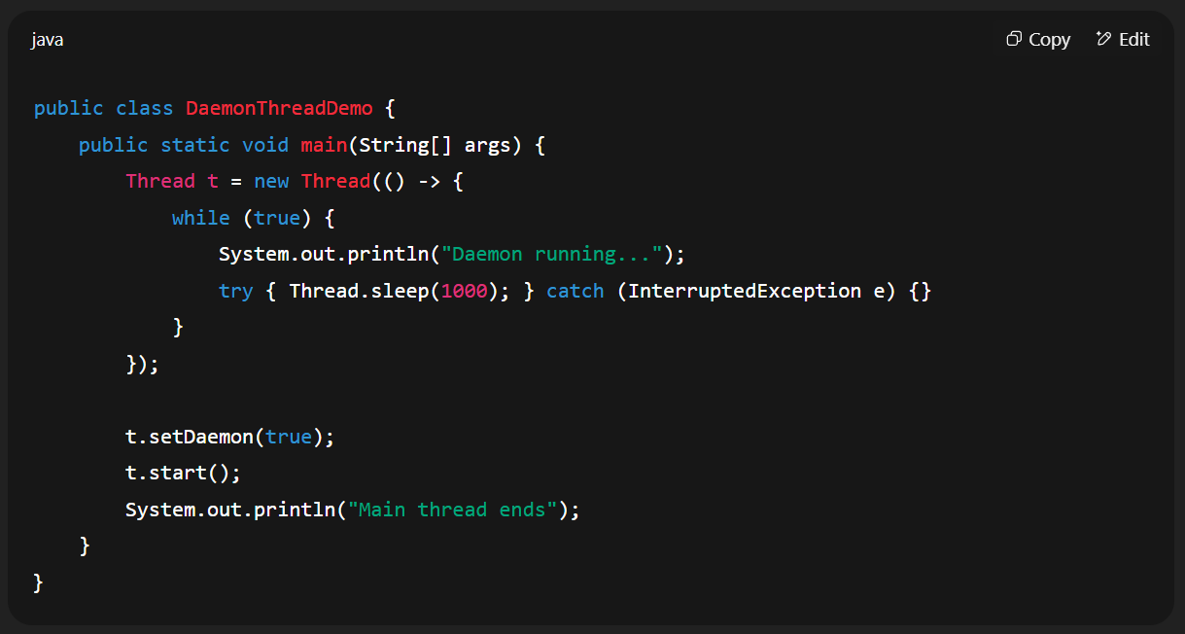
Daemon vs User Threads
User Threads: Keep JVM running until they finish.
Demon Threads : JVM exits when only daemon thread remain.

Slide 14
Thread Management Methods
start() :: Starts a new thread and calls run() internally
run() :: Contains the task logic (runs in same thread if called directly).
sleep(ms) :: Pauses the thread for given time.
join() :: Waits for another thread to finish.
yield() :: Suggests scheduler to pause current thread.
interrupt() :: Sends a signal to stop waiting/sleeping threads.

Slide 15
Synchronization Mechanisms
Intrinsic Locks (Synchronized)
synchronized method vs blocks
Reentrancy
Locking Mechanisms
java.util.concurrent.locks.Lock interface
ReentrantLock
Try-Lock and Fair Lock
Condition Variables
Atomic Variables
AtomicInteger, AtomicReference

Slide 16
Why Synchronization is Needed
Problem: When multiple threads access shared resources at the same time without proper coordination, race condition and inconsistent states can occur.
Goal : Synchronization ensures mutual exclusion and visibility.

Slide 17
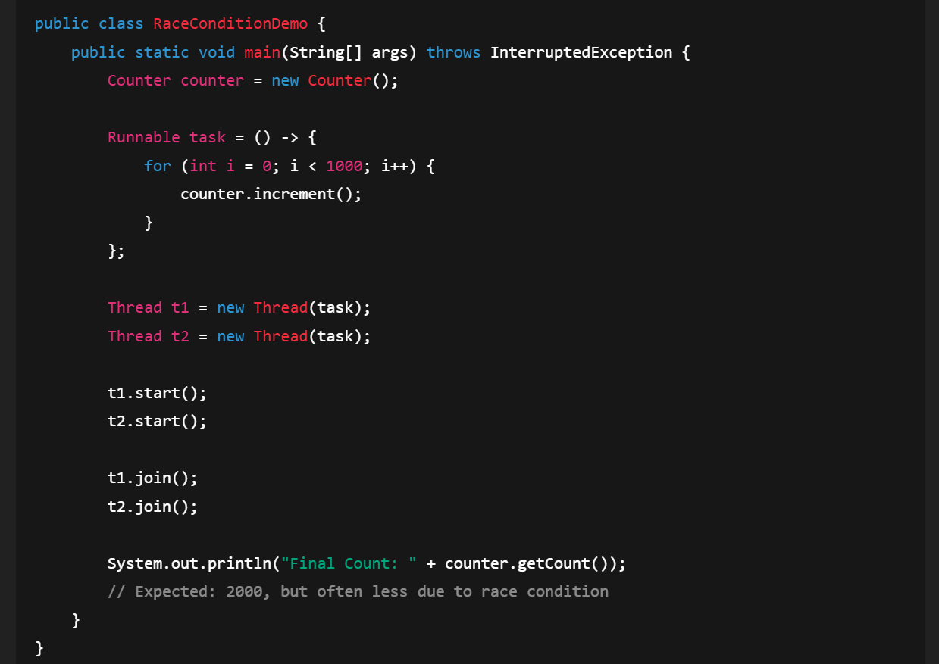
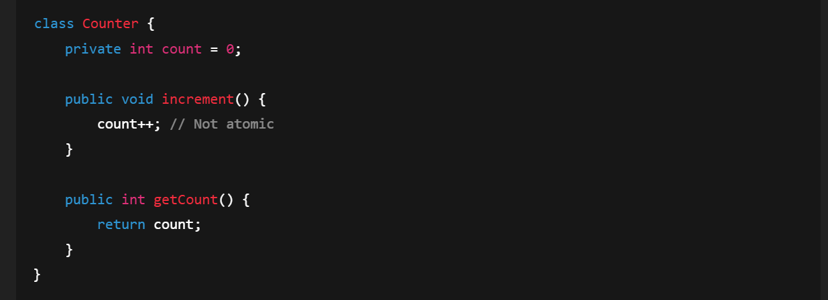
Without Synchronization

Slide 18
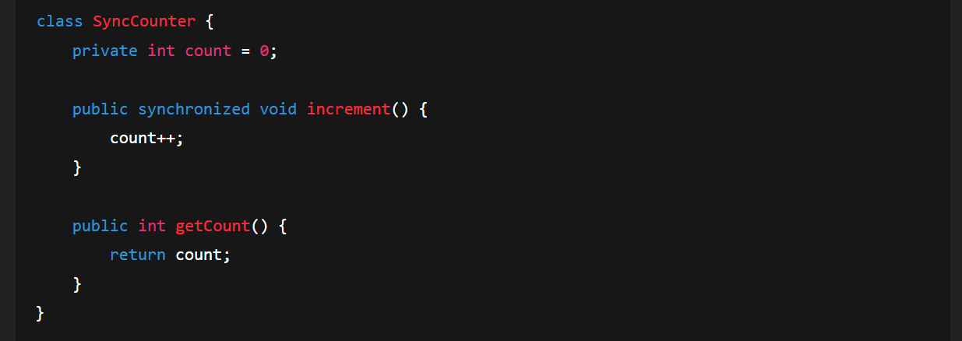
Synchronized Methods

Slide 19
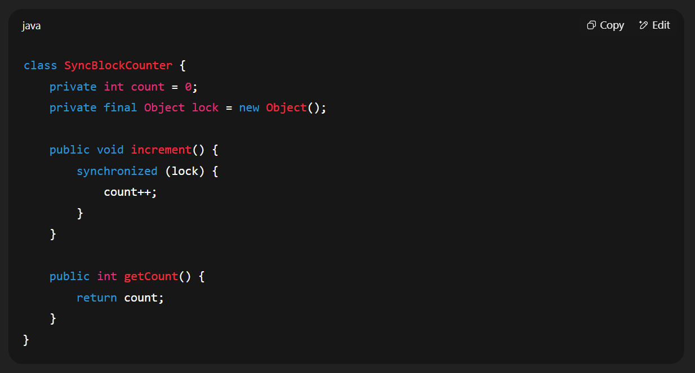
Synchronized Block

Slide 20
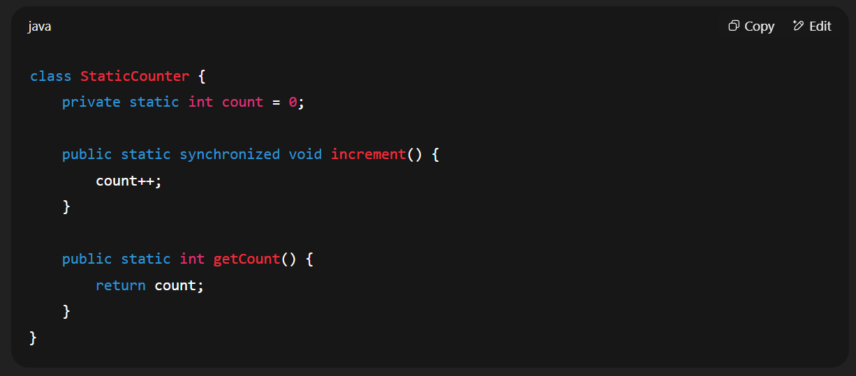
Static Synchronization
Used when threads access static variables.
Locks on the class object instead of instance.

Slide 21
tryLock, timed lock, fairness
tryLock()
What it does:
Attempt to acquire the lock without waiting indefinitely.
If lock is available, it acquires and returns true.
If not available, it immediately returns false
Why use it:
Prevents a Thread from blocking forever when the lock is not available.
Useful in scenarios where you have alternative work to do if the lock is buzy.

Slide 22
Time Lock (tryLock(timeout, TimeUnit))
tryLock(timeout, TimeUnit)
What it does:
Attempts to acquire the lock, waiting only for the specified time.
If the lock is acquired within that time, returns true; otherwise returns false.
Why use it:
Avoids deadlock situations by allowing threads to give up after some time instead of waiting forever.

Slide 23
Fairness
Fairness
What it does:
When creating a ReentrantLock, you can pass true to its constructor for fair mode.
In fair mode, Threads acquire the lock in the order they requested it(first-come, first-served).
In non-fair mode(default), Threads may “Jump the queue” if the lock becomes free and they are ready to run
Why use it:
Fairness is important when you want predictable ordering and avoid thread starvation.
But it comes with slight performance cost

Slide 24
Condition Variables
A condition object let's threads communicate about state changes while using an explicit Lock.
It’s like wait() / notify() in synchronized blocks, but it works with Lock instead of synchronized.
Why use Condition?
You want finer control over Thread waiting and notification.
You need multiple wait-sets for single lock(producer waits on one condition, consumer waits on another).
You want to avoid the limitations of intrinsic locks( wait/notify )

Slide 25
Atomic Variables
An Atomic Variables (like AtomicInteger, AtomicLong, AtomicReference) supports lock-free, thread-safe operations using CPU-level atomic instruction( CAS - Compare and Swap)
Why use Atomic Variables?
Avoids explicit synchronization for counters/flag.
Non-blocking - better performance under contention.
Thread-safe without synchronized.

Slide 26
Java Memory Model (JMM) & Visibility
Java Memory Model Basics
Heap, Stack, Working memory
Happens-Before Relationship
Why it matters in concurrency
Problems in Multi-threading
Race conditions
Visibility issues
Instruction reordering
Volatile Keyword
When to use volatile
Hands-on Exercise:
Example of race condition and fix using volatile

Slide 27
What is Java Memory Model (JMM)?
The JMM defines how threads interact through memory and what behaviours are allowed in concurrent execution.
Ensures consistency and visibility of shared variables between threads.
Without JMM rules, threads might see stale values or execute operations out of order
The JMM ensures visibility, ordering and atomicity.

Slide 28
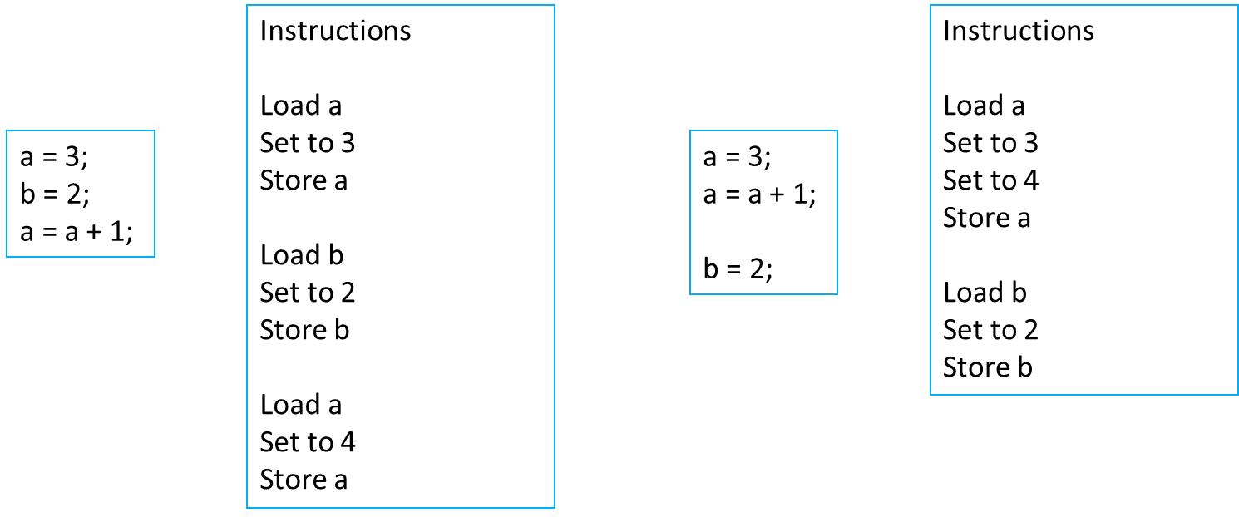
Instruction Reordering

Slide 29
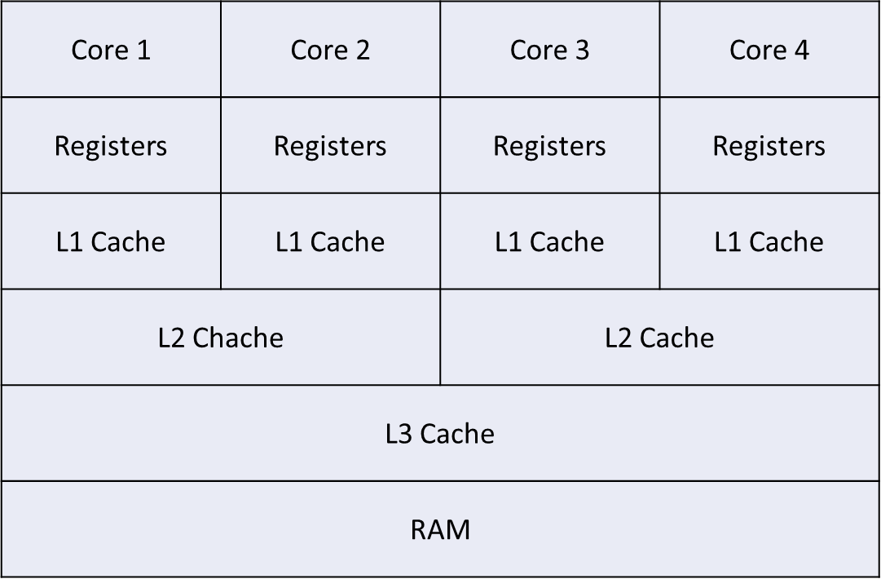
Key Concepts in JMM

Slide 30
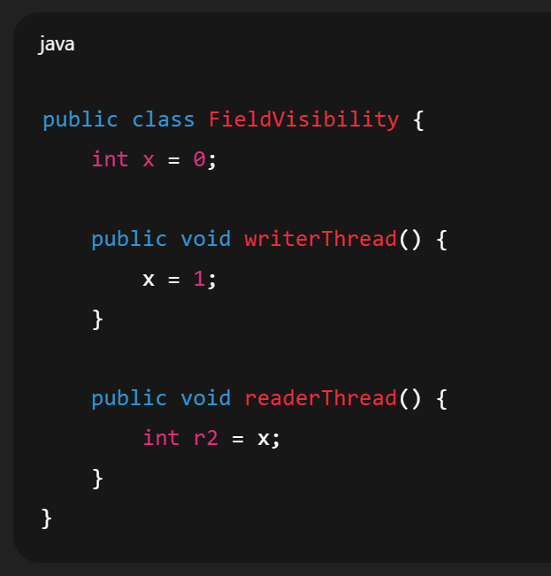
Field Visibility
Thread 1
Thread 2
Core 1 | Core 2
Local Cache | Local Cache
Shared Cache
x = 0
r2 = x
x = 1
x = 0
x = 0

Slide 31
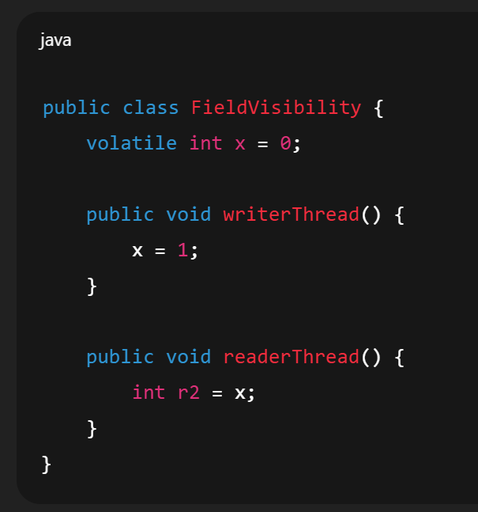
Field Visibility
Thread 1
Thread 2
Core 1 | Core 2
Local Cache | Local Cache
Shared Cache
x = 1
x = 1
x = 0
x = 1
x = 1

Slide 32
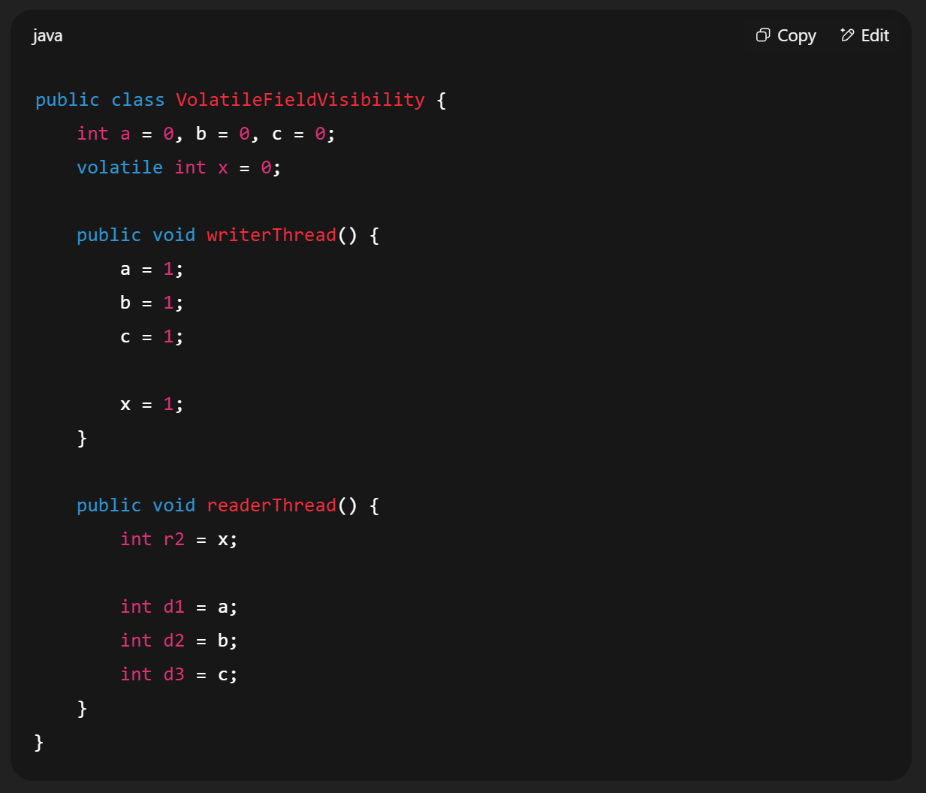
Happens-before relationship
Also applicable for
Synchronized
Locks
Concurrent Collections

Slide 33
Difference Between Volatile and Atomic Integer
Volatile
Purpose : Ensures visibility of changes to a variable across threads.
What is does
When one thread updates a volatile variable, the new value is immediately written to main memory.
Any other thread reading the variable sees the latest value directly from main memory
What it does not do
It does not make operation atomic
Example : counter++ is not safe even if counter is volatile because counter++ is read – modify – write (3 steps)
When to use:
When multiple threads read/write a single variables and no compound operation is needed.
Example : A flag to stop threads – volatile boolean running = true

Slide 34
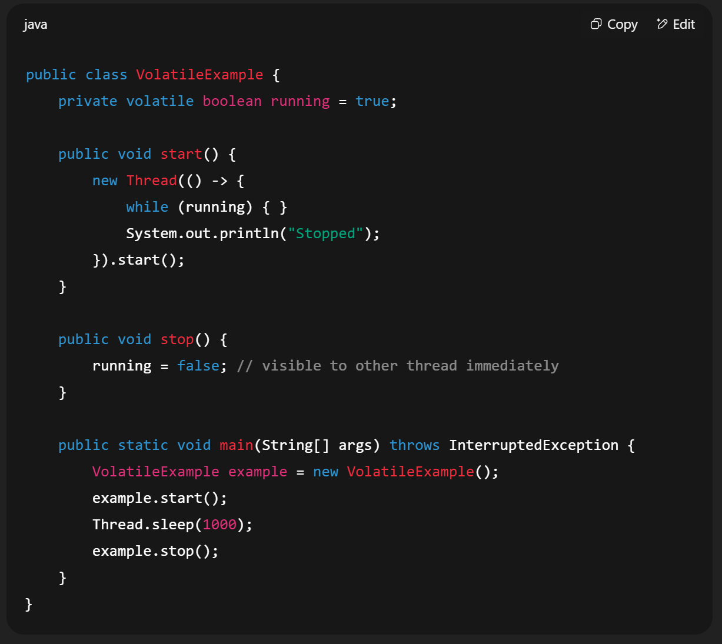
Example

Slide 35
AtomicInteger
Purpose: Provides atomic operations on an integer value without using synchronized.
What is does
Supports atomic methods like incrementAndGet(), decrementAndGet(), compareAndSet()
Ensures both visibility and atomicity.
When to use:
When multiple threads update a counter or perform arithmetic on a shared variable safely.
Suitable for counters, sequence generators and stats tracking

Slide 36
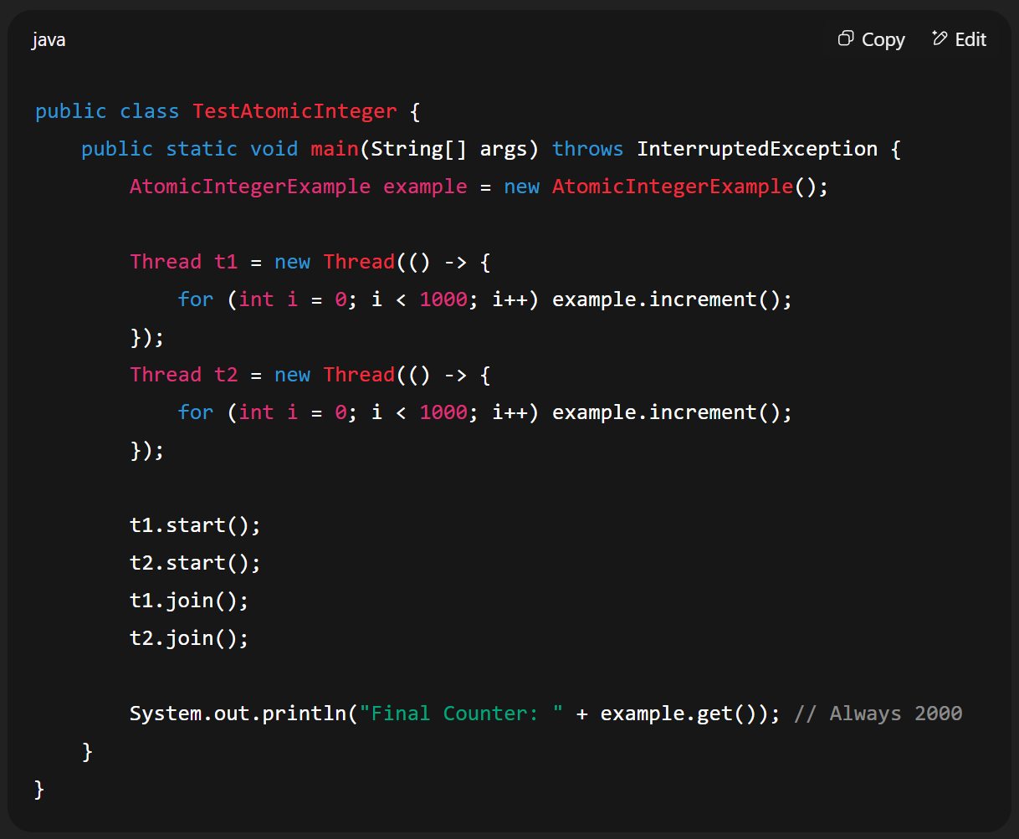
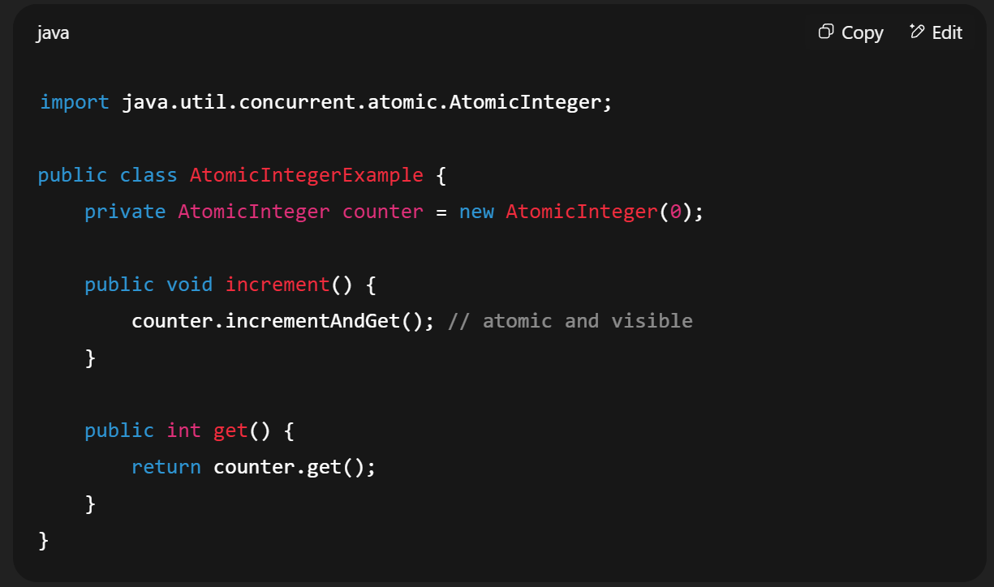
Example

Slide 37
Introduction to Concurrency
What is Concurrency and Parallelism?
Difference between Concurrency vs Parallelism
Benefits and challenges of concurrency
Java Concurrency Overview
Single-threaded vs Multi-threaded applications
Use cases for concurrency in Java
Thread Life Cycle and States
NEW, RUNNABLE, BLOCKED, WAITING, TIMED_WAITING, TERMINATED
Thread state transitions with diagram
Hands-on Exercise:
Create a simple multi-threaded program using Thread class and Runnable interface

Slide 38
Concurrent Collections
Need for Thread-Safe Collections
Legacy vs Modern
Vector and Hashtable
Collections.synchronizedXXX()
Java Concurrent Collections
ConcurrentHashMap
CopyOnWriteArrayList
ConcurrentLinkedQueue
BlockingQueue (ArrayBlockingQueue, LinkedBlockingQueue)
Hands-on Exercise:
Producer-Consumer using BlockingQueue

Slide 39
Need for Thread-Safe Collections
When multiple threads access and modify a collection at the same time without synchronization it can cause
Data corruption
Unexpected exceptions (e.g. ConcurrentModificationException)
Lost updates

Slide 40
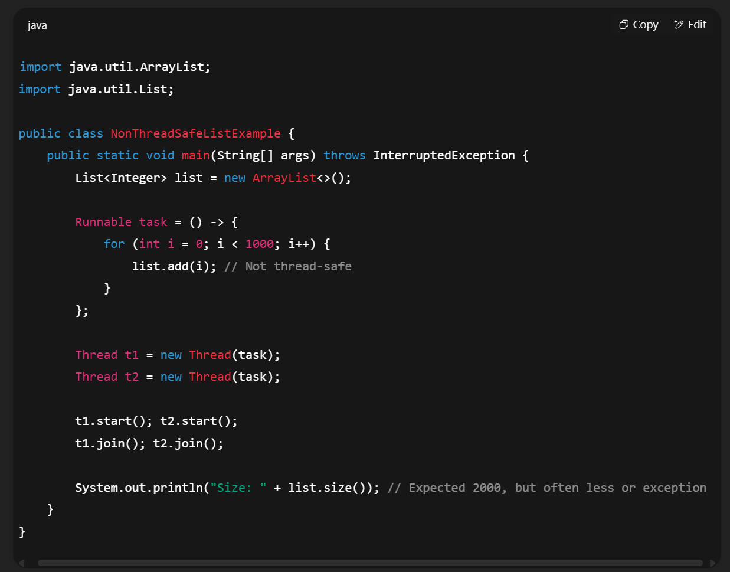
Need for Thread-Safe Collections

Slide 41
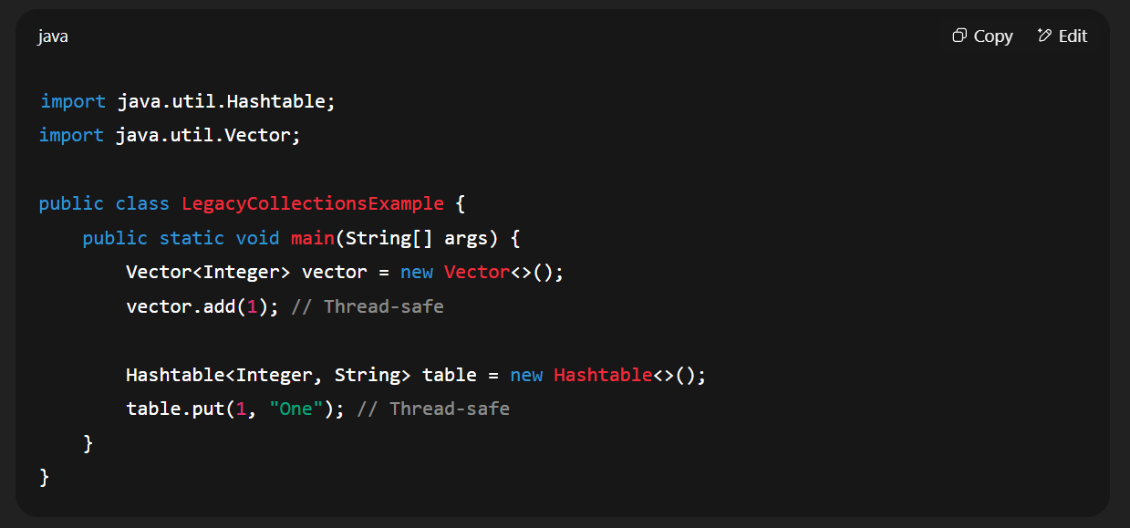
Legacy vs Modern
Legacy Thread-Safe Classes
Vector ( Thread-safe alternative to ArrayList)
Hashtable (Thread-safe alternative to HashMap)

Slide 42
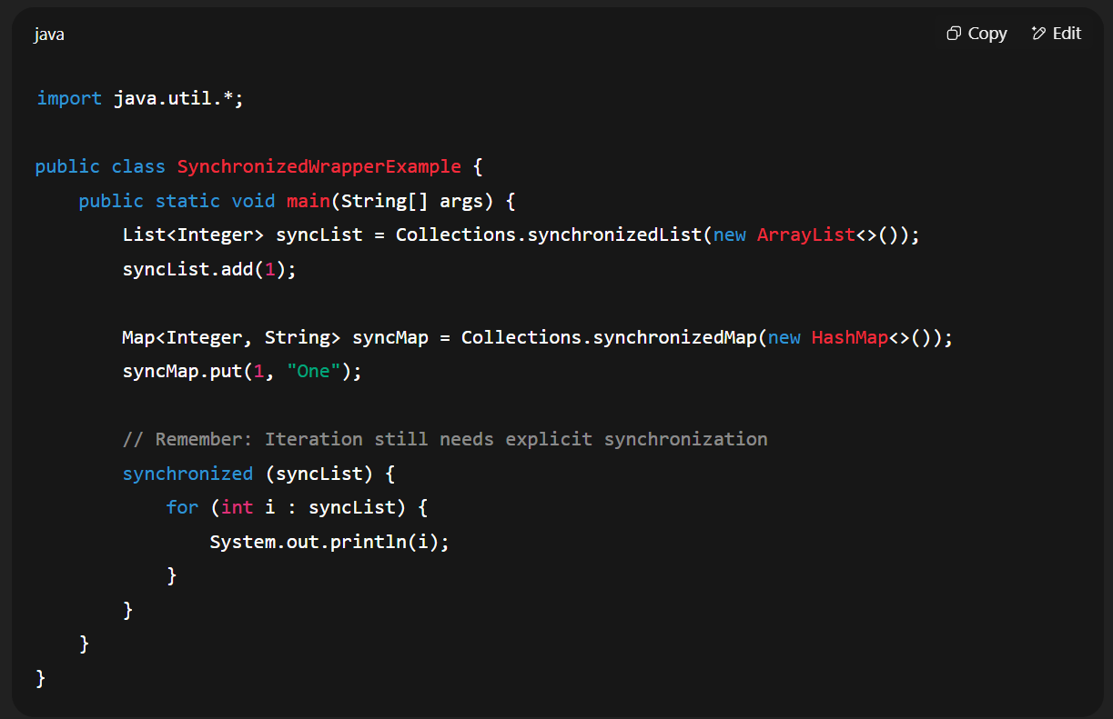
Collections.synchronized Wrapper method
Java provides wrappers to make existing collections synchronized.

Slide 43
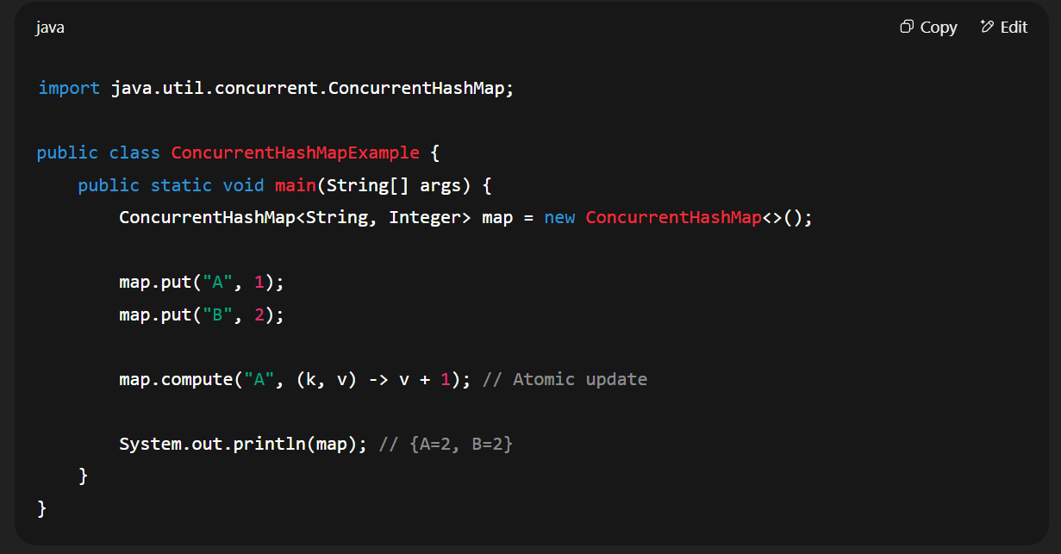
Java Concurrent Collections
ConcurrentHashMap
Allows concurrent reads without locking
Uses segment-based locking for writes

Slide 44
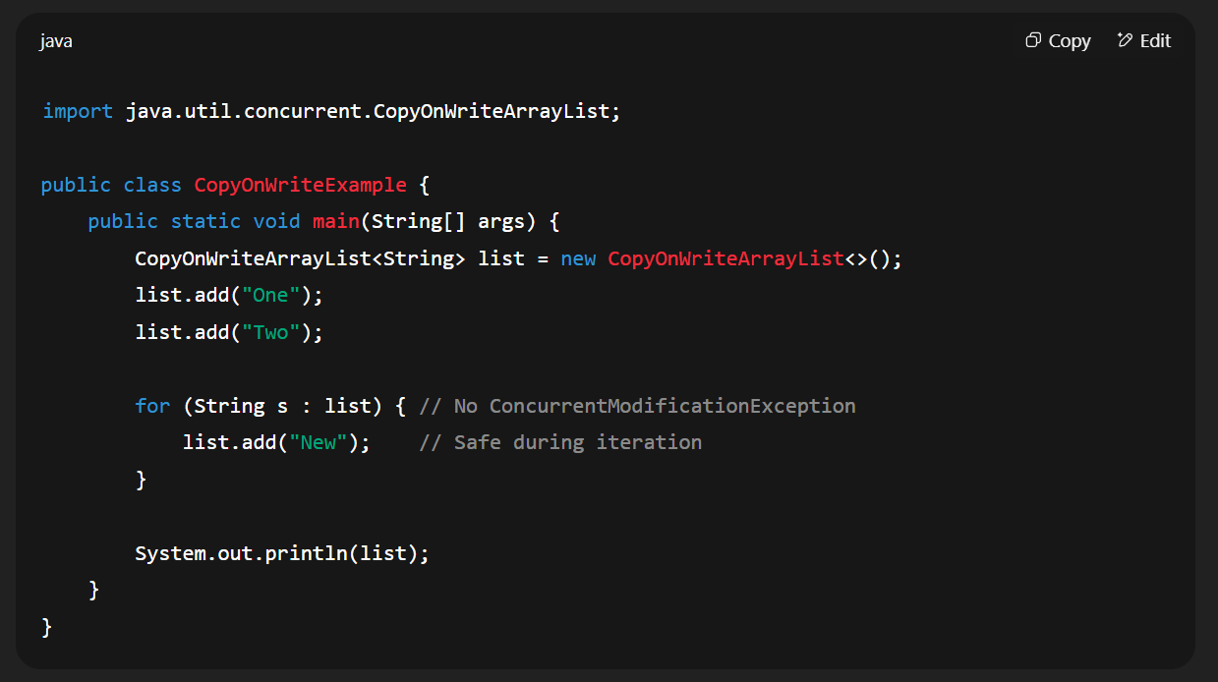
Java Concurrent Collections
CopyOnWriteArrayList
Best for read-heavy operations
Creates a new copy of the list for every modification

Slide 45
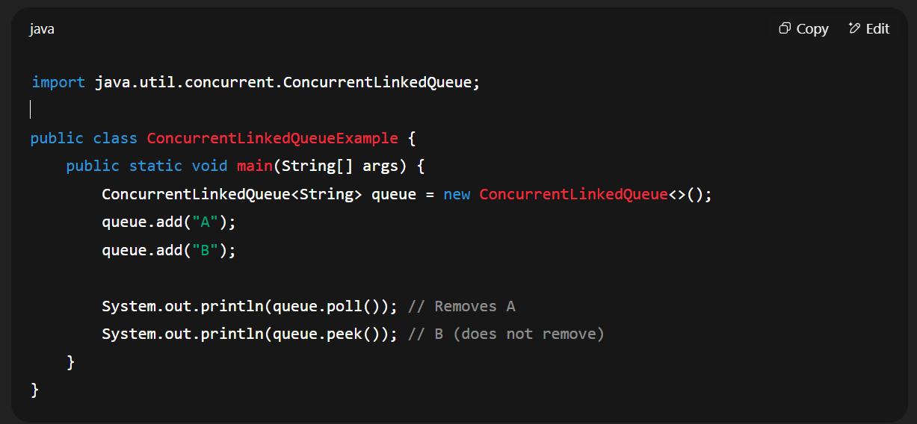
Java Concurrent Collections
ConcurrentLinkedQueue
Lock-Free, thread-safe FIFO queue
Good for producer-consumer tasks.

Slide 46
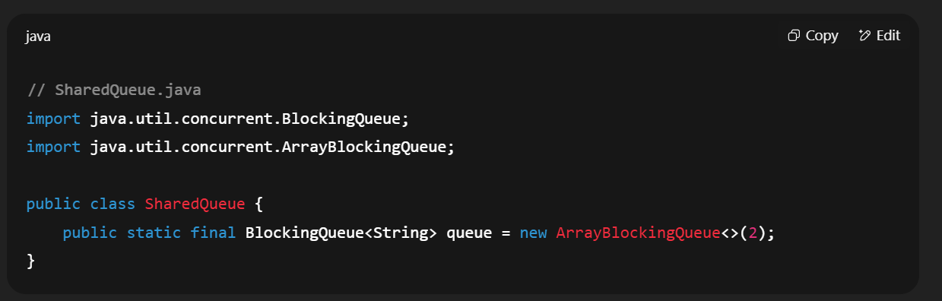
Java Concurrent Collections
BlockingQueue
Designed for producer-consumer scenarios
Blocks when queue is empty(for take) or full (for put)

Slide 47
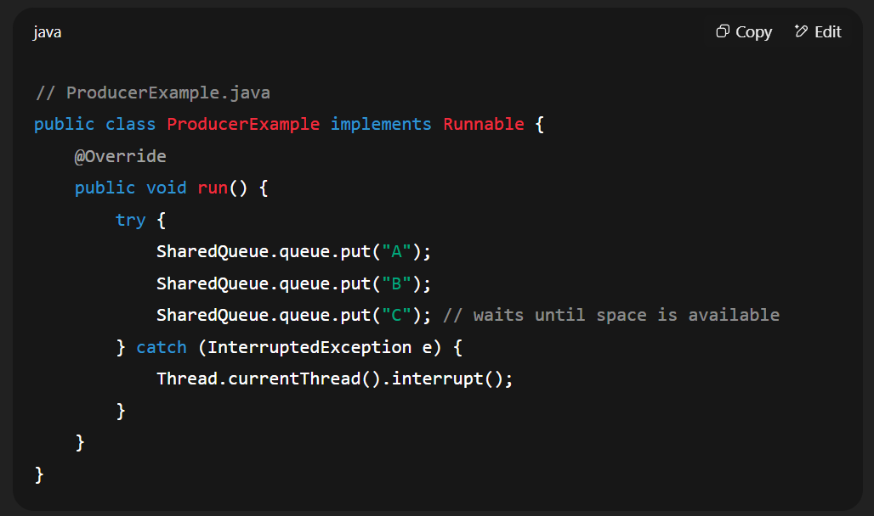
Java Concurrent Collections

Slide 48
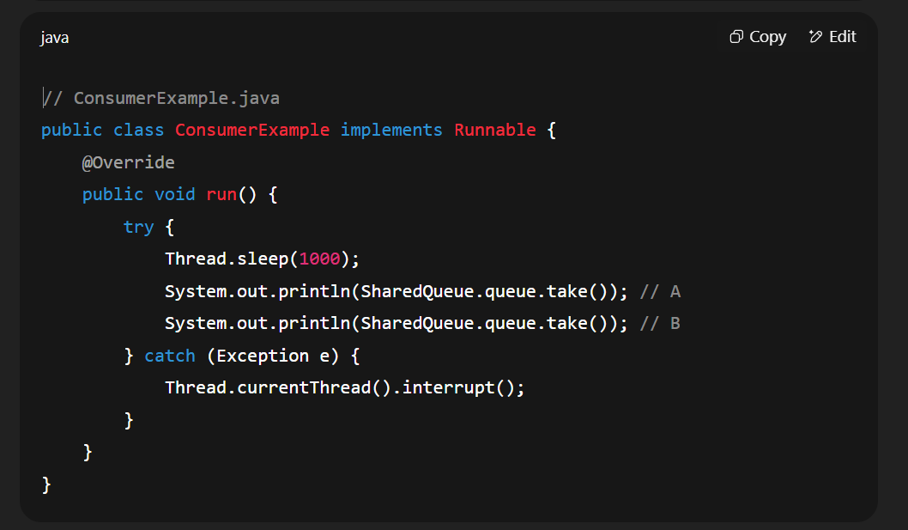
Java Concurrent Collections

Slide 49
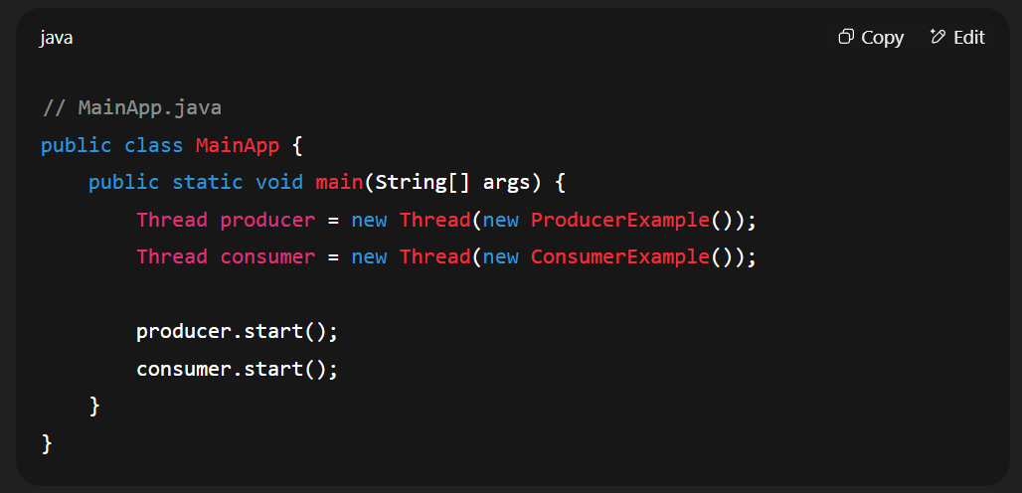
Java Concurrent Collections

Slide 50
Executors and Thread Pools (1 hour)
Why Executors instead of Manual Threads?
Executor Framework
Executor, ExecutorService
ThreadPool Executors
Fixed, Cached, Scheduled, Single
newFixedThreadPool(), newCachedThreadPool(), newScheduledThreadPool()
Submitting tasks
execute() vs submit()
Callable and Future
Hands-on Exercise:
Implement a task using ExecutorService and Future

Slide 51
Why Executors instead of Manual Threads?
Manual thread creation is costly – creating too many can crash the system.
No reuse – once a thread finishes, it’s gone.
Hard to manage – tracking, interrupting and scheduling is tricky.

Slide 52
Executor Framework
The core interfaces are
Executor – basic interface with execute(Runnable) method
ExecutorService – extends Executor and adds lifecycle management (shutdown, awaitTermination)

Slide 53
SingleThreadExecutor
SingleThreadExecutor runs one task at a time in the same thread.
Useful when you want sequential task execution without manually handling threads.
Task are executed in the order they were submitted.

Slide 54
FixedThreadPool
It’s an ExecutorService that reuses a fixed number of Threads.
Once a Thread finishes a task, it is reused for the next task(no new thread are created unless a thread dies).
If you submit more tasks than available threads, the extra tasks wait in a queue until a thread becomes free.
When to use it
When you have a large number of short tasks and want to limit concurrent threads.
Good for controlling resource usage and avoiding thread-creation overhead.

Slide 55
CachedThreadPool
It’s an ExecutorService that creates new Threads as needed, but will reuse previously create threads if they are available/
Idle threads are terminated after 60 seconds of inactivity
When to use it
When you have many shot-lived asynchronous tasks.
When you want to handle sudden bursts of requests without worrying about predefining thread counts.
Not good if you have too many long-running tasks – can lead to too many threads being created and high CPU/memory usage.

Slide 56
ScheduledThreadPool
It’s am ExecutorService that can schedule tasks to run after a delay or periodically at fixed rate or with fixed delay between runs.
When to use it
For running delayed tasks (start something 5 second later)
For periodic jobs (check server health every 10 seconds)
For replacing Timer in multi-threaded applications
Scheduling Methods
schedule(Runnable, delay, timeUnit) → run once after delay.
scheduleAtFixedRate(Runnable, initialDelay, period, timeUnit) → run repeatedly with a fixed rate between start times.
scheduleWithFixedDelay(Runnable, initialDelay, delay, timeUnit) → run repeatedly with a fixed pause between end of one run and start of next.

Slide 57
Callable and Future
Callable is like Runnable but returns a value and can throw checked exceptions.
Future represents the result of an asynchronous computation.

Slide 58
What is it used for?
Perform possible asynchronous(non-blocking) computation and trigger dependent computations which could also be asynchronous.

Slide 59
Basics of Asynchronous Operation
main thread
separate thread
Task
Runnable
❌

Slide 60
Basics of Asynchronous Operation
main thread
separate thread
Task
Callable

Slide 61
Runnable (vs) Callable
Runnable (vs) Callable comes into point when we are using Executer framework.
ExecutorService is a subinterface of Executor, which accepts both Runnable and Callable tasks.
Earlier Multi-Threading can be achieved using Interface Runnable(Since 1.0), but here the problem is after completing the thread task we are unable to collect the Threads information. In-order to collect the data we may use Static fields.

Slide 62
Working with Callable and Futures
Let's Check small code example

Slide 63
Visualize The Callable And Future Example
main thread
thread-pool
Blocking queue
Future<Integer> future = service.submit(new Task());
Task 1
Task 2
Task 3
…
placeholder
Once result is ready
Fetch next task
From queue
Execute it
3
Set value of placeholder
t0
t1
t2
t3
….
t10

Slide 64
Visualize The Callable And Future Example
main thread
thread-pool
Blocking queue
Future<Integer> future = service.submit(new Task());
Task 1
Task 2
Task 3
…
placeholder
blcoked
future.get()
Once result is ready
Fetch next task
From queue
Execute it
3
Set value of placeholder
runnable
Run dependent taks
t0
t1
t2
t3
….
t10

Slide 65
There Is A Problem
main thread
thread-pool
Blocking queue
for 1..4
service.submit(new Task())
Task 1
Task 2
Task 3
…
7
5
blcoked
future.get()
Once result is ready
Fetch next task
From queue
Execute it
1
7
5
runnable
Run dependent taks
t0
t1
t2
t3
….
t10

Slide 66
Dependent tasks
Fetch Order
Enrich Order
payment
For All orders
Dispatch
Send Email

Slide 67
Independent Flows
Independent Flow
Fetch Order
Fetch Order
Fetch Order
Enrich Order
Enrich Order
Enrich Order
payment
payment
……………….
payment
Dispatch
Dispatch
Dispatch
Send Email
Send Email
Send Email

Slide 68
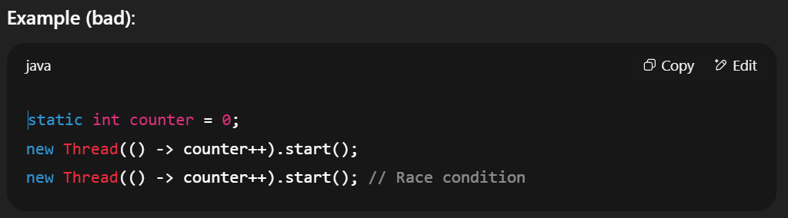
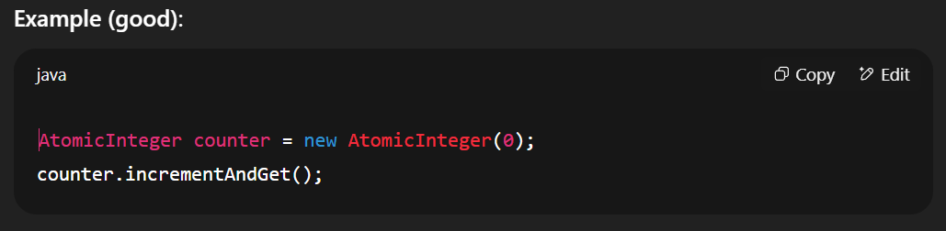
Best Practices for Concurrent Programming
Avoid Shared Mutable State
What it means: Multiple threads accessing and modifiying the same variable/object can cause race conditions.
Why : Even if each operation looks simple, combined effects may be unpredictable without synchronization.
Best Practice
Share immutable object instead
If you must share mutable data, use thread-safe structure( ConcurrentHashMap, CopyOnWriteArrayList) or synchronized access.

Slide 69
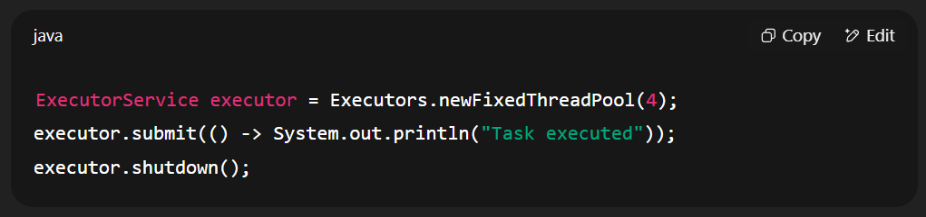
Best Practices for Concurrent Programming
Prefer Higher-Level Concurrency API Over Low-Level Threads
What it means : Instead of manually creating and managing Thread objects, use ExecutorService, CompletableFuture
Why:
Simplifies thread lifecycle management
Better resource utilization
Easier to handle errors and timeouts

Slide 70
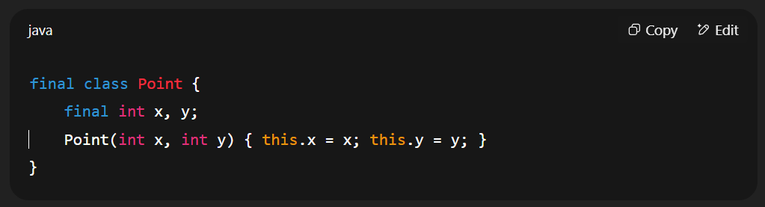
Best Practices for Concurrent Programming
Use Immutability Where Possible
What it means:
Immutable objects cannot be changed after creation.
Why:
No synchronization needed — safe to share between threads.Simpler reasoning about code.

Slide 71
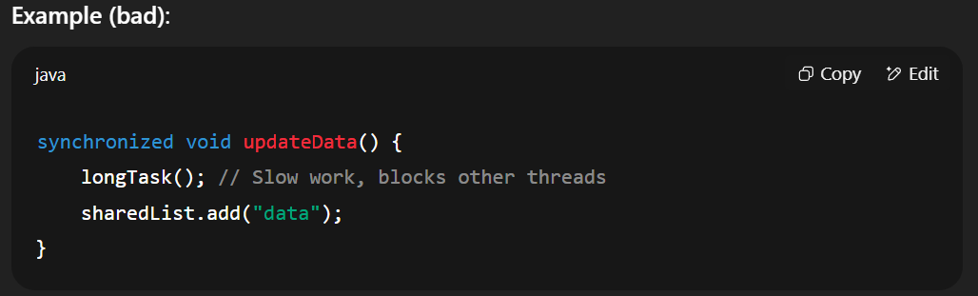
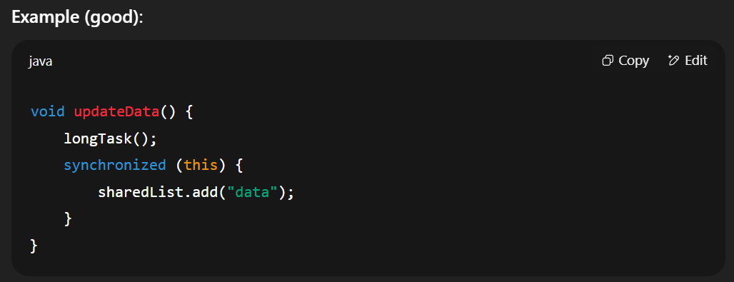
Best Practices for Concurrent Programming
Keep Critical Sections Small
What it means:
Critical sections are blocks of code that are synchronized or locked.
Why:
Smaller sections reduce contention and improve performance.Avoid putting I/O or long computations inside locks.

Slide 72
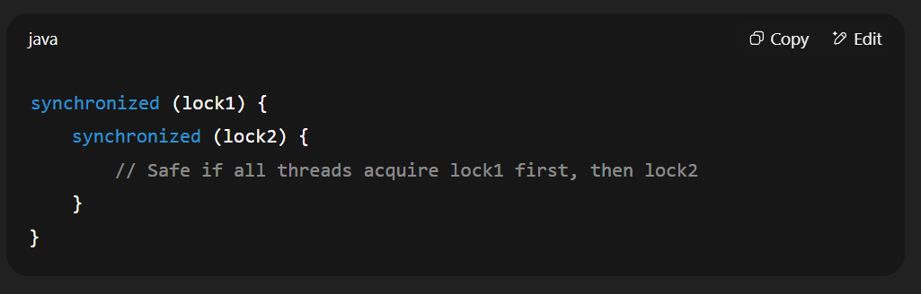
Best Practices for Concurrent Programming
Best Practices for Concurrent Programming
Deadlock: Two or more threads wait for each other’s resources forever.
Strategies:
Lock ordering — Always acquire locks in the same order.
Timeouts — Use tryLock(timeout, unit) instead of lock() forever.
Minimal locking — Reduce lock scope.

Slide 73
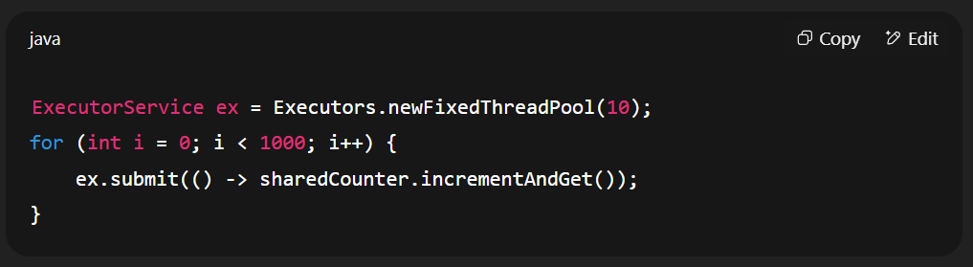
Best Practices for Concurrent Programming
Thread Safety Testing Tips
Why it's tricky:
Concurrency bugs are timing-dependent and may not always appear.
Tips:
Use stress testing — run code in loops with many threads.
Use tools like jcstress (Java Concurrency Stress tests) or FindBugs/SpotBugs.
Introduce artificial delays to increase race condition probability.
Test on multi-core machines to expose real parallelism issues.

